Slide 1
How much of God do people see in me?
Notes:
What plant’s are these?
Red Currant
Strawberry
So we identify the plant by the fruit it produces.
It’s obvious that if I want strawberries I plant a strawberry plant, and not a red currant.

Slide 2
Luke 6
39And He also spoke a parable to them: “A blind man cannot guide a blind man, can he? Will they not both fall into a pit? 40“A pupil is not above his teacher; but everyone, after he has been fully trained, will be like his teacher. 41“Why do you look at the speck that is in your brother’s eye, but do not notice the log that is in your own eye? 42“Or how can you say to your brother, ‘Brother, let me take out the speck that is in your eye,’ when you yourself do not see the log that is in your own eye? You hypocrite, first take the log out of your own eye, and then you will see clearly to take out the speck that is in your brother’s eye. 43“For there is no good tree which produces bad fruit, nor, on the other hand, a bad tree which produces good fruit. 44“For each tree is known by its own fruit. For men do not gather figs from thorns, nor do they pick grapes from a briar bush. 45“The good man out of the good treasure of his heart brings forth what is good; and the evil man out of the evil treasure brings forth what is evil; for his mouth speaks from that which fills his heart.
Notes:
I will pull out various points from this verses as we go along. 44 Each tree known by it own fruit.
So we are known by our fruit.
When you look at Jesus life he did lots and lots of things like
Heal sick, cast out demons fed people.
Those were his actions
But what was his fruit/s did he show?

Slide 3
If are core belief system is based on Gods truth the fruit of this will be expressed in us having thoughts and behaviours that line up with fruits of holy spirt.
Galatians 5:22-23 New American Standard Bible (NASB)
²² But the fruit of the Spirit is love, joy, peace, patience, kindness, goodness, faithfulness, ²³ gentleness, self-control; against such things there is no law.

Slide 4
John 14 v9
New American Standard Bible
Jesus said to him, "Have I been so long with you, and yet you have not come to know Me, Philip? He who has seen Me has seen the Father; how can you say, 'Show us the Father '?
1 John 3 New American Standard Bible (NASB)
3 See [a]how great a love the Father has bestowed on us, that we would be called children of God; and such we are. For this reason the world does not know us, because it did not know Him.
Notes:
You shall be know by your fruit. So for Jesus his fruit revealed his father.
Jesus by his fruit and actions revealed the father.
We are children and as children of God we to prepresent our father just like Jesus did. So that when people see me they see Jesus and my father God.
When people look at us how much of the father do they see? And how can they see more?

Slide 5
Galatians 5
18But if you are led by the Spirit, you are not under the Law.19Now the deeds of the flesh are evident, which are: immorality, impurity, sensuality, 20idolatry, sorcery, enmities, strife, jealousy, outbursts of anger, disputes, dissensions, factions, 21envying, drunkenness, carousing, and things like these, of which I forewarn you, just as I have forewarned you, that those who practice such things will not inherit the kingdom of God. 22But the fruit of the Spirit is love, joy, peace, patience, kindness, goodness, faithfulness, 23gentleness, self-control; against such things there is no law.24Now those who belong to Christ Jesus have crucified the flesh with its passions and desires.
25If we live by the Spirit, let us also walk by the Spirit. 26Let us not become boastful, challenging one another, envying one another.
Notes:
If we carry on read in galatians 5 before the fruits of the holy spirit it talks about the deeds of the flesh.
And if we know what the fruits of the holy spirit our then the fruits of the flesh will be the opposite to these.
Jesus didn’t display any deeds or fruit of the flesh yet if we are honest how much do we? Jesus does not expect us to be prefect but as followers of him the idea is to be on a jorney. To be more like him. His is summed up in this verse
2 Corinthians 3 v18
But we all, with unveiled face, beholding as in a mirror the glory of the Lord, are being transformed into the same image from glory to glory, just as from the Lord, the Spirit.
The fruits of holy spirt and Jesus life are a great plumb line ot see what areas we need to change. The way we identify areas of change is any area where I am moving in fruits and deeds of the flesh.

Slide 6
2 Corinthians 3 v18
But we all, with unveiled face, beholding as in a mirror the glory of the Lord, are being transformed into the same image from glory to glory, just as from the Lord, the Spirit.
Notes:
The plumbline is Jesus.

Slide 7
Fruit of the Flesh
We will experience the opposite of fruits of the spirit
Instead of Love, Feel unloved or feel have to earn love
Instead of Joy, Feel miserable, sad, depressed
Instead of peace, Feel stressed or fear
Instead of patience, will be impatient and not thinking clearly
Instead of kindness, we will be selfish or thinking selfish thoughts
Instead of faithfulness, have thoughts of giving up on ourselves or others or God, unreliable
Instead of gentleness, we will be harsh, or thinking harsh thoughts
Instead of Self control, we will be uncontrolled, or reckless or outburst of angry
Notes:
So any areas I display fruits and deeds of flesh are areas that I am not like Jesus. I can settle and just say that’s how I am.
Yet if we are honest how do moving these things make us feel?
HBC core value is bringing healing, wholeness and freedom.
Would it be safe to say someone who moves mainly in the fruits of holy spirt is someone who is healed, whole and free?
How do we become more life Jesus and have more fruits of the sprit and less fruits of the flesh?

Slide 8
Flesh or Spirit?
Notes:
Example 2
So imagine this. Same situation. Bob
My boss is horrible and always putting pressure on me to get stuff done, and I am struggling to keep up.
I am at peace, even though it is hard sometimes.
Dig a bit deeper.
When I applied for the job I beleived it what God was saying for me to do and the right job for me.
I have since prayed and checked and asked God if still the right place, and he not said no so believe this is still where God wants me.
I examine myself and believe that I am doing my best and doing it in a way that honours God, even though I am struggling to keep up.
I start praying blessing over my boss, that God would bless them.
I ask God for wisdom and his strategy on if there is anything I need to do different in work.
Both people can be in exactly the same situation and one is at peace. Now will everyone notice that even though its hard for Bob some days, will Bob’s work mates notice how he is?
See the fruit of holy spirit of bob beign at peace, of still loving his boss, reveals Jesus.
So how does Bobbie become Bob. Bobbie, needs to remove the flesh, that core belief that says I am not good enough.
Now I would say that bobie having this removed is Bobbie going on a journey on being more healed, more whole and more free.
God’s heart is we are fully healed, fully whole and fully free.
The more healed, whole and free the more reveal Jesus and reflect him.
Laura to speak

Slide 9
Process involved
Identify area God is challenging to change, usually done by suddenly being aware of negative fruit in our lives
Then with help of holy spirit and likely others help to uncover what is going on and causing negative fruit to grow
Areas to look for
Unforgiveness and judgment
Hurt
Ungodly belief (a belief that goes against what God says)
Wrong agreement or vows
So need to process to come to place of forgiveness, giving pain to God, repenting, breaking the lie of the ungodly belief you believe and replace with truth and repenting and breaking vow/agreement. Good to do this all with someone.
Notes:
This jorney therefore is for all of us.
You can be sat here this morning and think I don’t really have anything to be healed from. But if there are areas where you still have fruits or deeds of flesh there is a journey to go on
You might be sat here knowing that you have lots of pain and it’s to hard. I have personal experience. It is hard, but it worth it.
As British people we are not always good at talking and particularly areas where we struggle, as christains we can sometimes be even harder as we feel shame and its only me. As men we can be even worse.
Freedom is worth fighting for.
The exciting truth is we can all be more like Jesus. All be more healed, whole and free. Do we have the guts to start this journey.

Slide 10
So the challenge
Do I give the holy spirit permission to high light areas in my life where I am not living in his truth of who he says I am?
Do I know I am loved by him unconditionally?
Am I secure in being his child?
Is he favourably inclined towards me? (without me having to earn it?)
Am I willing to go on this journey, might need chatting to people to help.

Slide 11
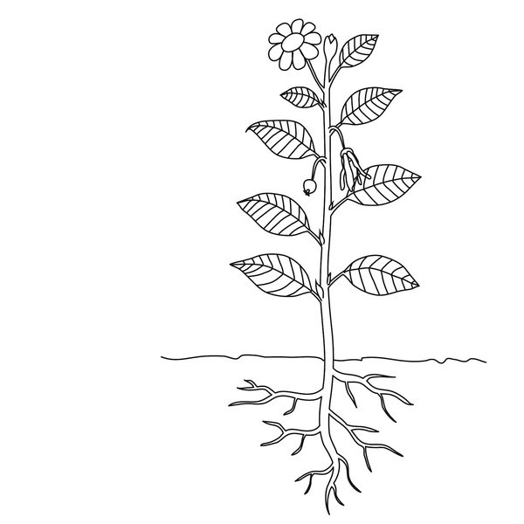
When I sin I repent,
I have confident that I can still worship him and he loves me.
When other say hurtful things it may hurt, but I know I am still loved and only believe what God says about who I am, his voice trumps all others.
I a loved regardless of what I do
My father loves me spending time with him
I am a child of God
I am loved unconditionally
He is pleased with me
This Photo by Unknown Author is licensed under CC BY-ND

Slide 12
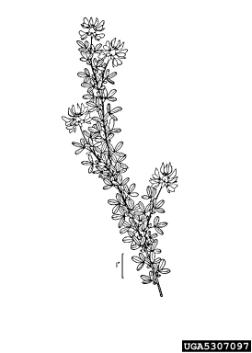
When I sin I repent, but still feel like I have to earn God’s love or I can’t be close till I have done something good for him
When other say hurtful things it may hurt, and I agree with some of their statements Like yes I am not good enough
My father likes spending time with me but he prefers others to me, or others are more talented/gifted than I am
I am loved if I do good stuff for God

Slide 13
How do we live in more of the reality that we are children of God?
Verses
John 8
³¹ So Jesus was saying to those Jews who had believed Him, “If you continue in My word, then you are truly disciples of Mine; ³² and you will know the truth, and the truth will make you free.”
Notes:
Example of Lock.
Abide/Remain/ Continue to be present in his word.
This is more than just reading his word and knowing it.
Then says you will know the truth.
Welcome Laura to talk about her journey

Slide 14
How do we live in more of the truth that we are Childern?
Verses
Romans 12
1Therefore I urge you, brethren, by the mercies of God, to present your bodies a living and holy sacrifice, acceptable to God, which is your spiritual service of worship. 2And do not be conformed to this world, but be transformed by the renewing of your mind, so that you may prove what the will of God is, that which is good and acceptable and perfect.
Notes:
Word cofonformed means conform one's self (i.e ones mind and character to another pattern
Renew to renovate a complete change.
This completely sums up this process that Laura has gone through.
And God's heart for us to.

