Slide 4
2 Timothy
The overall theme for the teaching is:
“Made For More”
Paul’s last letter to his protégé Timothy – the desire in Paul to see Timothy fulfil his calling and purpose in God by “drawing the gold” from him – the important of having a “Paul” in your life and for you to find a “Timothy” – “disciple makes a disciple who makes a disciple”

Slide 5
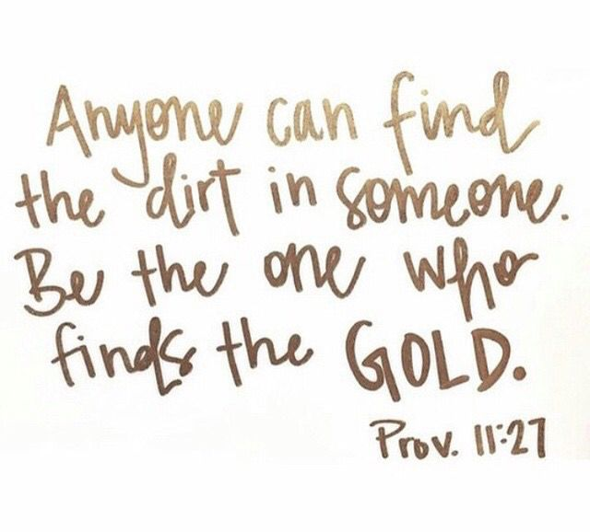

Slide 6
