Slide 1
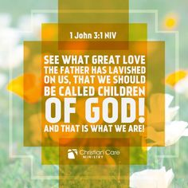

Slide 2
Notes:
Different Sizes of Gathering
As I’ve thought, prayed and learned from people way smarter than I will ever be, I think ONE angle for resolving these tensions is the recognition that church gatherings were never meant to be a “one size fits all”. We are to express the body of Christ in different physical spaces —
the 5 Contexts of Discipleship.
This is about recognizing the strengths of different sizes, both in our growth as disciples and as we help disciple others.

Slide 3
Notes:
‘The Five Kinds Of Relationships God Uses To Help Us Grow’, the book looks at the 5 Contexts, or 5 sizes of gathering, or 5 types of relationship, where God shapes and disciples us — and calls us to shape and disciple others.
The Public Context: we gather in the 100s, around a shared event or experience. That outside resource is what unites us in such a large gathering.
The Social Context: groups of 20-70, where we build bonds of affinity as we reveal snapshots of who we are. This is the most social of the Contexts, and is akin to a (healthy) extended family, gang or tribe.
The Personal Context: 4-12 people, where we share private information to a closer group of people, who both encourage and also bring challenge.
The Transparent Context: totaling 2-4 people, this is where we are completely transparent and open with the very closest of friends, including your spouse if you are married.
The Divine Context: you are alone with God your Creator and your Redeemer. In this place, the foundations are laid for success in the other four Contexts.

Slide 6
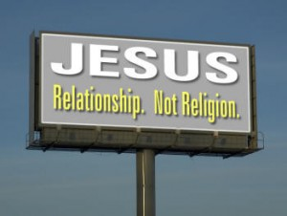
Notes:
Personal relational and walk with God
Time alone with God – Father Son and Holy Spirit
Identity, Destiny and Truth are formed in this place – one on one relationship

Slide 7
Notes:
Core pillars of our gatherings.
Song
Scripture
Story
Sacrament
Spirit
Adults and Children
However, Sunday Gatherings are really not great environments for many other aspects of discipleship, especially those related to close and authentic relationships especially when you have over 100 adults involved

Slide 8
Notes:
This is the arena that churches struggle to do well
Is the place of 20 to 70 people sharing snapshots of who they are and so building friendship and affinity with one another eg a BBQ, Picnic coffee shop (regular attendance)
I church we swing between the public, the social and the small group for our expressions of being church that isn't personal or public (Sundays)

Slide 9
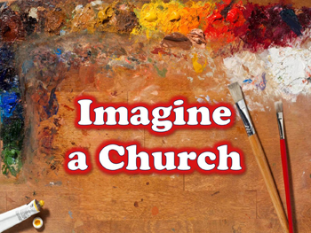
Notes:
A Missional Community Definition In 6 Words:
FRIENDSHIP – authentic community occurs, so people can belong before they believe, and will experience an extended family atmosphere
FOCUS – there is a common mission to a specific group of people (this is a ‘who’, not a ‘what’)
FUN – everyone gets to contribute in every area and has fun on the way
FOOD – eating together is the primary activity of the community as its the is one of the primary ways of fostering a sense of family
FIRED UP – our aim is to make disciples who make disciples – we are believing believers who love God, love one another and love our world.
A Missional Community Definition In A Sentence:
A missional community is an extended family of relationships, cantered around Jesus, who go and make disciples amongst a specific group of people

