Slide 1
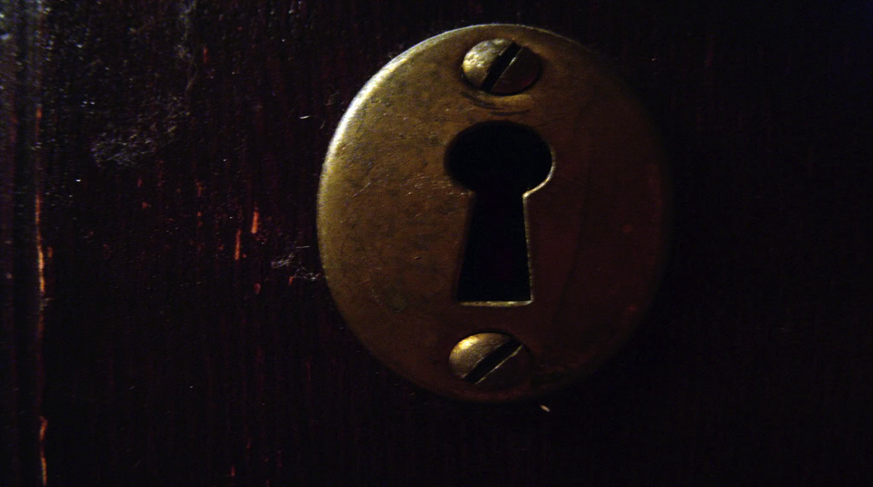
Recognising People of Peace

Slide 2
Notes:
FOR: God’s posture towards humanity is one of pleasure—fundamentally He loves and smiles when He looks at us! He is for us. Yet He is also a holy God (represented by the halo). While He loves us so deeply, God also hates sin for the basic fact that it stands in direct opposition to His very identity and rule.
WITH: To draw us closer to Him, God comes to be with us, revealing His nature and love to us in more tangible ways. The Old Testament is full of moments when He was with His people: the call of Abraham, Moses at the burning bush, Ruth when she chose the God of Naomi, Jeremiah in the pit, Daniel in the lions’ den.
But this is not enough. When God is with us, He is still holy and, to sinful humanity, too different and unattainable to follow consistently. We fail at keeping
His law and thus end up discouraged (the grumpy face!) both at our own sin and God’s otherness.
ONE OF: The crucial shift is when God becomes one of us—the incarnation.
But God doesn’t stop there. There’s even better news: In Jesus, God becomes One Of us. “For In Christ lives all the fullness of God In a human body” (Colossians 2:9). Eugene Peterson says it this way in The Message: “The Word became flesh and blood and moved into the neighborhood” (John 1:14).
God moved into OUR neighbourhood! Jesus puts on human flesh (here represented by the baseball cap), and at last our hearts
can stop striving. We see what it means to belong to our heavenly Father when we look at Jesus; we see how our lives can be transformed when the Holy Spirit is allowed to lead us so closely. The frown turns into a smile!
IN: Finally God can be in us—as we welcome, receive and serve Jesus. As the Holy Spirit comes to live in us, not only do we smile but we also start to take on the character and identity of God—His holiness.
The outcome of this process is that Jesus creates a multiplying movement—by commissioning us frail mortals, who have God in us—to go and represent Him in the world.

Slide 3
The question really is that simple— who do you sense God has called you to love the most? Who is your heart best shaped to reach for Jesus?

Slide 4
A Person of Peace
They welcome you
They receive you (and the Jesus in you)
They serve you
You intentionally invest in them
They operate as a gate keeper
Ultimately ‘A person of peace is one who is prepared to hear the message of the Kingdom and the King’ - Mike Breen

Slide 5
Notes:
Heal the sick who are there and tell them, “The Kingdom of God has come near to you” (Luke 10:9).
As you begin to identify your Person of Peace, the obvious next issue is what you can do to be proactive in drawing them to the Lord.
After all, it is all very well identifying people who are open to Jesus as He lives through me, but that is of no use eternally if they never join me on the journey of discipleship.
The next step boils down to a simple principle:
Treat your non-Christian friends the same way you treat your Christian friends.
If one of my Christian friends says that he’s feeling unwell, my response is to offer to pray for them—right then.
I’ll place a hand on their shoulder and pray a simple prayer of faith.
Why can’t we do the same with our non-Christian friends?
Whenever I’ve done so, two things happen:
1. Jesus heals them—which leads to some really fun conversations (“So then, what do you reckon happened there?”)
2. They aren’t (fully) healed, but they are really touched by what they receive as an authentic expression of love and compassion.

Slide 6
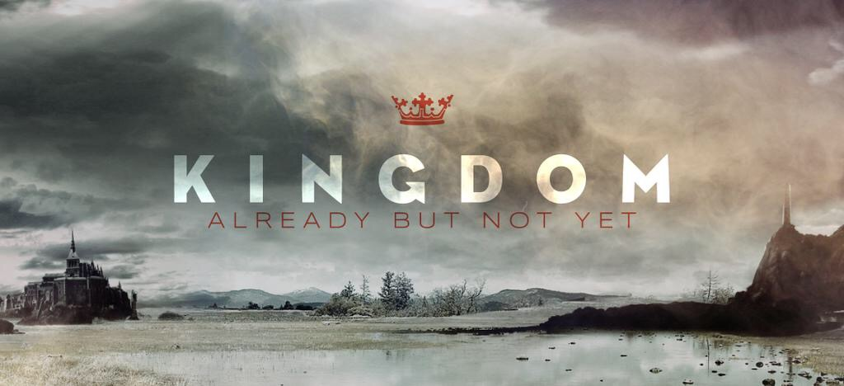
Notes:
Heal the sick who are there and tell them, “The Kingdom of God has come near to you” (Luke 10:9).
Matt 17: 19
Then the disciples came to Jesus privately and said, "Why could we not drive it out?“ And He said to them, "Because of the littleness of your faith; for truly I say to you, if you have faith the size of a mustard seed, you will say to this mountain, 'Move from here to there,' and it will move; and nothing will be impossible to you.
My faith for healing and deliverance greatly increased from what Jesus calls ‘so little’ to ‘as small as a mustard seed’, when I heard these simple words ‘the Father wants his children well’.
For me that changed everything, hearing that simple word took my general anticipation from ‘God can heal’ to ‘God will heal’.
Now I’m determined to keep on praying for the sick until one of three things happen,
The sick get healed
They die and go to heaven (where healing is complete and eternal)
Jesus returns (and the Kingdom of God comes in its fullness)
This is the only way I can live now. God has graciously spoken so clearly and so simply and now I have faith for these things.
So if today I were confronted by a similar situation to that which met the disciples as they came down from the mountain my faith would tell me that God wants the little boy delivered – however strong the demon might be.
But that was not the disciple’s faith. Like me on so many occasions they only had a faith to try but not a faith to succeed. They had seen it happen before – people getting delivered – so they thought it might happen again. But that’s not mountain moving faith. That’s more hope than faith.
Of course Jesus stepped in and helped the boy and I’m sure that’s happened many times in my life as I’ve prayed more in hope than faith. But like you I’ve wanted to learn how to grow in the naturally supernatural life and this has led me to the place that I’m at now.
If we do not have the humility to keep on asking the Lord for a word that gives us faith we will tend to approach these areas with excuses rather than solutions.
Perhaps we will come up with ‘theological reasons’ that excuse our inabilities. Perhaps we will say ‘God doesn’t heal today’ or ‘it must be Gods will that you’re sick’ (Yuk! I can’t stand Christian fatalism!). Maybe we will say that healing is not our gift. Perhaps we’ll just ignore the problem and hope it goes away.
All in all these alternative solutions tend to mean that when it comes to living a life modeled on the life of Jesus we operate more as functional agnostics than anything else. We believe that the supernatural life could be possible we’re just not sure that it will be possible – for us.
Of course I recognize that this is partly because so much so-called ‘supernatural ministry’ looks so repellent – more like a traveling circus than anything else. But this should not prevent us from seeking to be like Jesus in all he did.
So let’s go back to beginning; do you have a ‘word’ for the supernatural life – for healing and deliverance? If not why not? The counsel of Jesus appears to be that we should fast and pray until we hear it. (Mark 9:29)
We can live the naturally supernatural lifestyle but to do it we have to stop living as functional agnostics.

Slide 7
Influencing your People of Peace
Notes:
boiled things down to four questions that we ask (internally) when with a Person of Peace. They are:
1. Can I Pray for You?
2. Can I Serve You?
3. Can I Share My Story?
4. Can I Share God’s Story?

Slide 8
Notes:
1. Can I Pray for You?
Our starting place is an intentional openness to pray for those with whom we are starting to form community.
This first question keeps us humble and dependent upon God. Most leaders are pretty competent at organizing things; so serving others can easily be done in our own strength—not the wisest (or most effective) way to win someone to Jesus.
This is all about Jesus and His Kingdom, so we always reckon that He loves to be involved in extending His rule even more than we do!
If you’re still nervous about stepping out in faith like this, here’s an interesting anecdote: I have been turned down when offering to pray for someone—but only by Christians. My unchurched friends have never refused!
2. Can I Serve You?
There will be lots of practical ways to serve, love and “one another” People of Peace and their oikos relationships. Clearly, this is a wonderful way to express the reality of the Kingdom of God in tangible ways.
Your mission context will determine exactly what this might look like. Reaching the urban poor is different from serving secondary school kids or the upper middle classes in the suburbs. But the principle of loving service is the underlying theme.
As I noted earlier, the temptation can be to jump to this as a safe zone, so make sure that you aren’t doing this and skipping the “naturally supernatural” aspect of your witness.
3. Can I Share My Story?
In addition to being naturally supernatural and serving, we are also attentive to moments when we can share part of our story. Whether it is how we came to Jesus, significant moments along the way since then, or simply something He has done in the past seven days, these are our stories—and friends share their stories with one other.
Of course, my assumption here is that you already have a listening posture with the lost people you encounter, which is part of how you identify a Person of Peace
We need to be people who take time to listen, to genuinely know those we love and are called to love intentionally. The benefit of living like this is that it is not abrasive or rude when we share parts of our story about how Jesus has impacted us. In fact, it feels entirely appropriate and normal.
4. Can I Share God’s Story?
There comes a time and a place where we simply have to share the content of the gospel. That will involve us summoning courage, praying internally and opening our mouth to speak! Do you remember the bit about feeling like a lamb walking through a field of wolves? Jesus knows it will be scary, but having acknowledged that, He then doesn’t let us off the hook for witnessing.
Sometimes you will simply be sharing one idea, Scripture or insight about God. Other times, it might be some of the core content of the gospel, in a way that is appropriate for that person and the context you are in.
A lot is written about this aspect of evangelism, and there are plenty of great materials that can fill gaps in your knowledge of the Good News (e.g., what is the evidence for the existence of Jesus? Did He really rise from the dead? What about other religions?).

Slide 9
Influencing your People of Peace
Notes:
boiled things down to four questions that we ask (internally) when with a Person of Peace. They are:
1. Can I Pray for You?
2. Can I Serve You?
3. Can I Share My Story?
4. Can I Share God’s Story?
It is worth memorizing these questions, and seeing them as tools to select from in
the different conversations and situations you experience. Ask yourself:
• What is the story of this person?
• What is my history with them?
• What would be most helpful?
• How does the Holy Spirit seem to be at work right now?
• How can I step back to make room for the Holy Spirit to step forward?
Then go for it!

Slide 10
Notes:
identify seven markers of a Person of Peace. They suggest we use:
• Perception – sensing the Person of Peace’s openness to God.
• Presence – when you are present in a situation, you naturally draw Persons of
Peace to you because of your (Jesus-inspired) difference.
• Proclamation – speaking as Jesus would and seeing who responds.
• Passing Relationships – brief moments when you influence someone you will
otherwise not encounter again, such as at the checkout or on a plane.
• Permanent Relationships – those long-term connections with family and close
friends.
• Preparation – you cultivate the ground through your ongoing activities.
• Power – allowing God to impact people, for instance, through healing

