Slide 2
September
7 Introduction to the teaching series: Invitation to Abide
14 Week One: Invitation to Abide
21 Week Two: Prayer – “ask for anything you want and it will be granted”
28 “Pulse on Pause” - All Age Celebration - Harvest
October
5 Week Three: Bible – “his word remains in you”
12 Week Four: Overflow of Joy –“filled with my joy… your joy will overflow”
19 CAP Sunday
26 “Pulse on Pause” - All Age Celebration
November
2 Week Five: Sabbath Rest – “remain in me... remain in my love”
9 Week Six: Serving others – “I appointed you to go and produce lasting fruit”

Slide 3
“I am the true grapevine, and my Father is the gardener. He cuts off every branch of mine that doesn’t produce fruit, and he prunes the branches that do bear fruit so they will produce even more. You have already been pruned and purified by the message I have given you. Remain in me, and I will remain in you. For a branch cannot produce fruit if it is severed from the vine, and you cannot be fruitful unless you remain in me.
“Yes, I am the vine; you are the branches. Those who remain in me, and I in them, will produce much fruit. For apart from me you can do nothing. Anyone who does not remain in me is thrown away like a useless branch and withers. Such branches are gathered into a pile to be burned. But if you remain in me and my words remain in you, you may ask for anything you want, and it will be granted! When you produce much fruit, you are my true disciples. This brings great glory to my Father.
“I have loved you even as the Father has loved me. Remain in my love. When you obey my commandments, you remain in my love, just as I obey my Father’s commandments and remain in his love. I have told you these things so that you will be filled with my joy. Yes, your joy will overflow! John 15:1-11

Slide 4
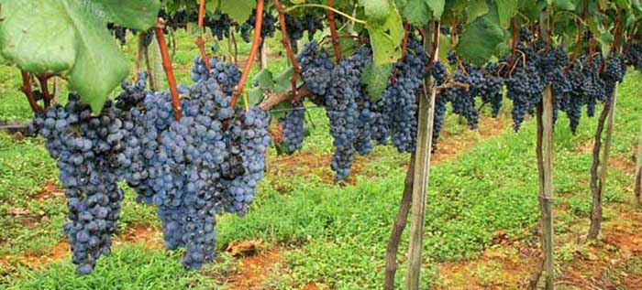
A Fruitful Vine
Notes:
Let’s reconstruct today’s scene as it may have happened. Jesus and his disciples have finished dinner and he has been talking with them. Immediately
prior to this passage, Jesus says, “Come, let us leave”. They leave, cutting across the city going east. They pass through the interior Valley Gate and
Huldah Gate before exiting through the main wall at the Golden Gate. With the temple rising over the walls of Jerusalem directly behind them, they made their way northeast, stopping shy of the Mount of Olives as they arrived at the Garden of Gethsemane. Along the way, they come across a grape arbor and Jesus, being a masterful teacher, uses the opportunity to teach. Remember that this was an agricultural society and all around the Mediterranean, grapes were a very common crop. All through the ancient world, the grape vine was a common literary symbol. Almost all the ancient Mediterranean cultures frequently used vine imagery in their literature.
However, the imagery strikes modern ears as kind of odd and it leaves us with some questions: What is this fruit? What is this about cutting off branches? What is this about pruning?

Slide 5
What is the fruit?
Notes:
First Question: What is this fruit that He’s talking about? What does it mean to bear fruit? Look at verses 10-11 (If you obey my commands… ). Here,
bearing fruit is about obeying Jesus commandments, particularly the commandment to love one another. So here, bearing fruit is about action — the
positive action of loving one another.
What about the rest of the New Testament? The first place to go when talking about fruitful living is Galatians 5:22. Paul here contrasts the fruit of the
Spirit against the acts of the sinful nature. Most of these fruits speak for themselves — they are feelings and states of being that have outward results.
Fruits are also actions — Look at Titus 3:14 and Ephesians 2:10. Fruit is right orientation of the heart and right action. I want you to notice something — these are all positive commandments. They are all, “Yes, do this.”
Christ calls us not to focus on a life of “no” but to a life of “yes” of fruit bearing. Behind every “thou shalt not” is an implied “thou shalt” to which we’re
called to aspire. You shall not kill because you shall honour the image of God in your fellow humans. You shall not commit adultery because you shall, through the quality of your marriage, give the world a picture of God’s love for his people.
You shall not covet because you shall recognize all the blessings he’s already given you. By obeying God’s commandments, particularly the commandment of
love, you bear fruit and you experience great joy.

Slide 6
The source of being fruitful is not you!!
Notes:
Jesus is stating really clearly the truth that way to be fruitful is to recognise and accept that you alone are unable to source any on going fruitfulness…
The source is outside of you…. – counter cultural –
so not about looking inside of yourself for the peace you need or the kindness you want to express
So not about you being the most gifted or talented person to be good enough to do this act or serve in this particular way
Fruit-bearing is not a matter of being strong or weak, good or bad, brave or cowardly, clever or foolish, experienced or inexperienced. Whatever your gifts, accomplishments, or virtues, they cannot produce fruit if you are detached from Jesus Christ.
Apart from me you can do nothing….

Slide 7
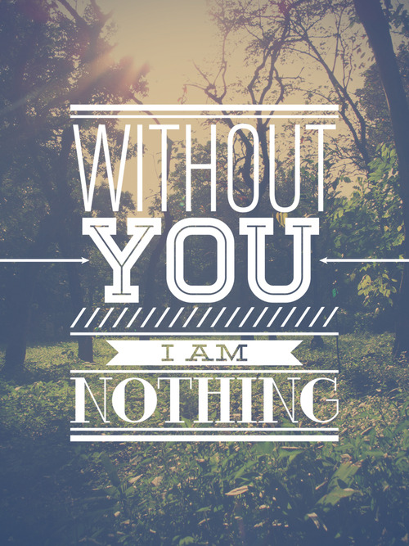

Slide 8
Invitation to Abide

Slide 9
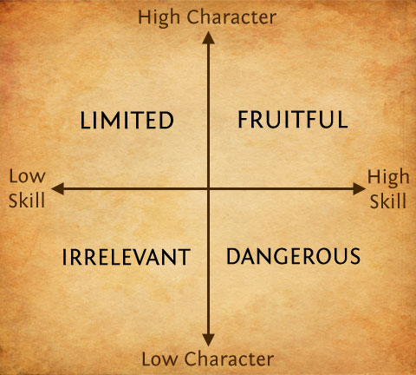
Character and Competence
Notes:
We are the most fruitful when we there a synergy between our character - feelings and states of being see Gal 5
“But the Holy Spirit produces this kind of fruit in our lives: love, joy, peace, patience, kindness, goodness, faithfulness, gentleness, and self-control.”
And our competence (skills) so we have developed things we can do: i.e. actions e.g. pray for people, hear the voice of God, read the bible etc…
Being a disciple of Jesus, then, is a person who is learning to be like Jesus and learning to do what Jesus could do growing in charcter to be more Christlike and growing in competence so we can do the things Jesus did….

Slide 10
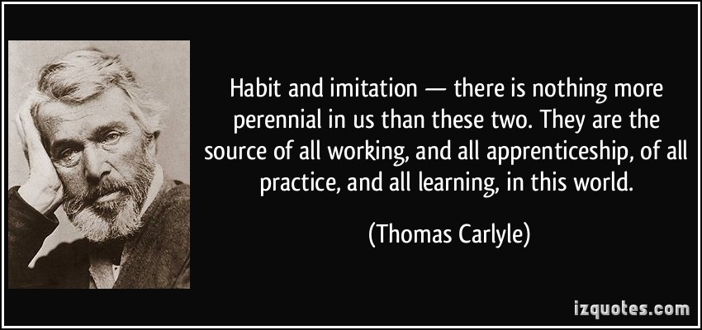
Notes:
Good habits and finding someone to imitate – are part of the invitation to abide
What one bad habit do you want to stop – let me suggest one – the negative confession
Replace with good habit – positive encouragement
Is there someone within HBC who you would like to imitate – something about there character or a skill they possess that you would like to grow in…
Go and tell them and what it is you want to imitate and ask them to pray and release this into your life and find out what good habits they have that has enabled them to be someone who could be imitated…
Habits and imitation will cause you to be friutful and live as a disciple…

